Slide 1
Object Detection On Indianapolis Racing Car Images: Using Retinanet
Manjulata Garimella

Slide 2
Goal
The goal of my project is to explore the performance of object detection models specifically RetinaNet on object detection of cars and smoke by using the Indianapolis car racing images.

Slide 3
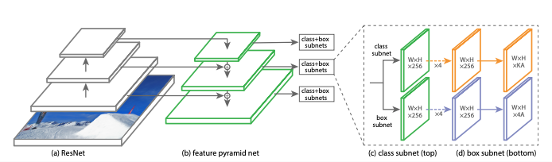
RetinaNet - One stage object detector
Focal Loss
Feature Pyramid Network (FPN)

Slide 4
Experiments and Results
Model 1 – Resnet50 model as the backbone network
Resnet-50 as feature extractor - that is pretrained on ImageNet. Adam optimizer was used with learning rate of 1e-5.

Slide 5
Experiments and Results
Model 2 - Resnet-152 as feature extractor - that is pretrained on ImageNet. Adam optimizer was used with learning rate of 1e-3.

Slide 6
Experiments and Results

Slide 7
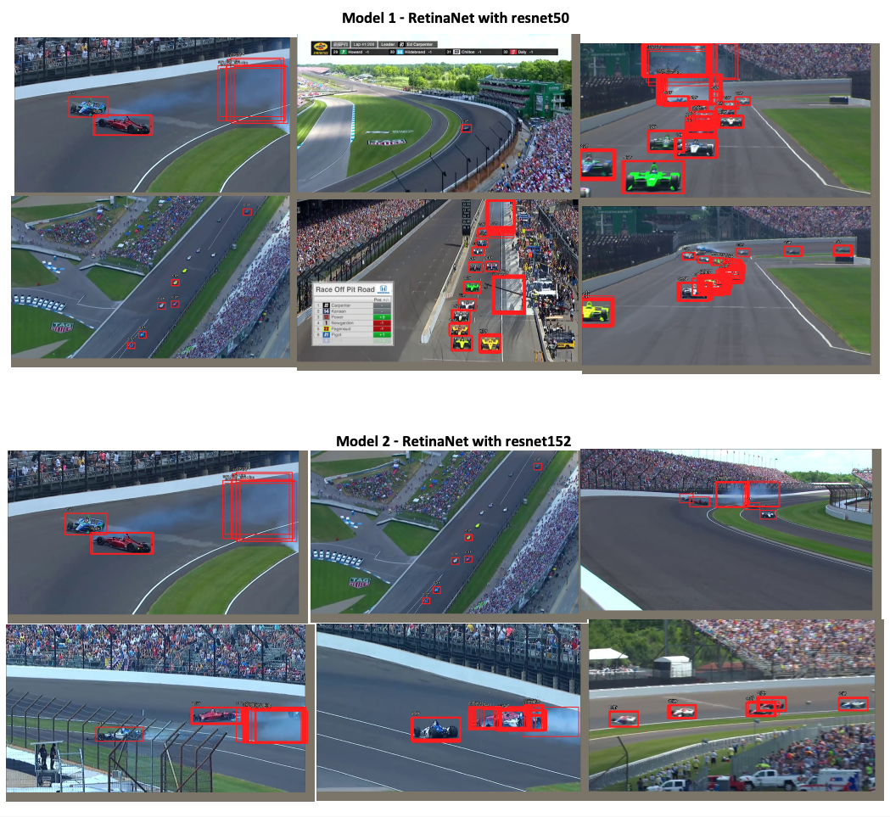
Experiments and Results

Slide 8
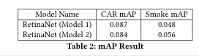
Experiments and Results
Model 1 - Average Elapsed Time: 0.238 sec
•
Model 2 - Average Elapsed Time: 0.34 sec

Slide 9
Conclusion
Current approach for object detection using Retinanet in its two
variants can be considered as a baseline result especially for smoke
detection.
The approach is simple and easy to train and has fast
inference times.
Future work:
Training data related to smoke images could be increased either with annotating more images or with the use of data augmentation techniques.
This will provide more training data and help train the model with large dataset and in turn results in larger mAP value

Slide 10
Thank you

